Slide 1
Image Processing with OpenCV
Debayan Banerjee Co-founder, Uberlabs

Slide 2
Introduction
What is Image Processing?
„any form of signal processing for which the input is an image; the output of image processing may be either an image or a set of characteristics or parameters related to the image. Most image- processing techniques involve treating the image as a two-dimensional signal and applying standard signal-processing techniques to it“

Slide 3
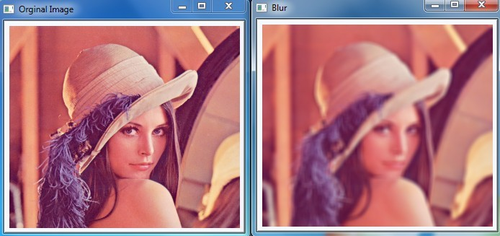
Examples
Smoothing

Slide 4
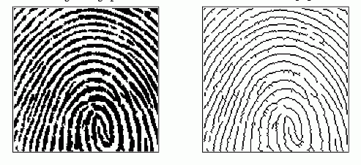
Examples
Erosion ↔ Dilation

Slide 5
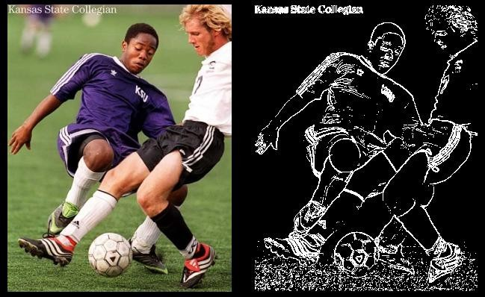
Examples
Edge detection

Slide 6
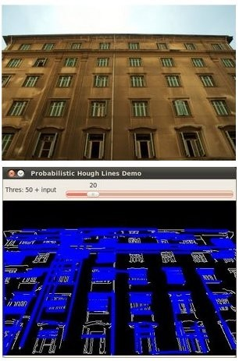
Examples
Hough line transform

Slide 7
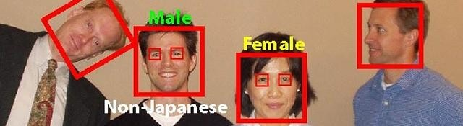
Examples
Face detection

Slide 8
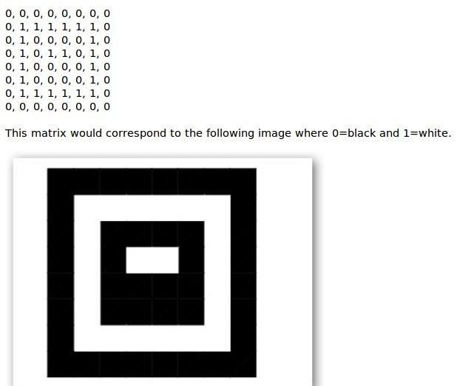
Basic Concepts
An image is a matrix

Slide 9
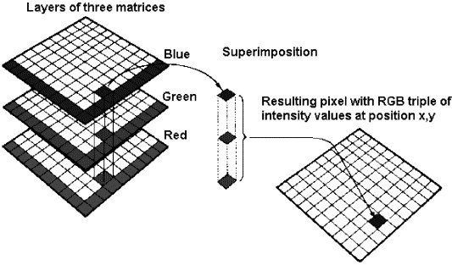
Basic Concepts
A colour image has 3 2-d matrices for R, G , B

Slide 10
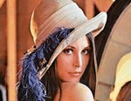
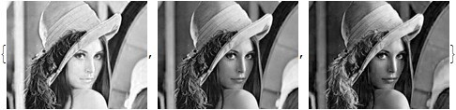
Basic concepts
Example

Slide 11
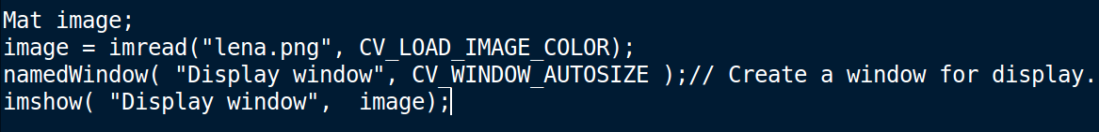
Basic operations: OpenCV
Reading and displaying images

Slide 12
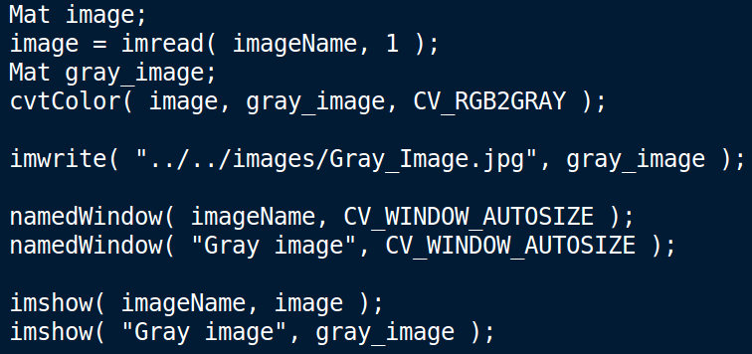
Basic operations: OpenCV
Writing images

Slide 13
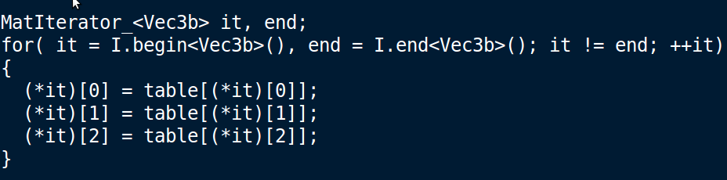
Core module: OpenCV
Accessing individual pixels

Slide 14
Core module: OpenCV
Contrast and Brightness adjustment
g(x) = a f(x) + b
a = Contrast parameter
b = Brightness parameter

Slide 15
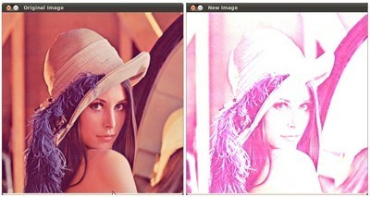
Core module: OpenCV
Contrast and Brightness example
a =2.2 b=50

Slide 16
Core module: OpenCV
Drawing functions
Lines Circles Ellipses Polygon

Slide 17
Image Processing
Smoothing – Removes noise
Uses filters like Gaussian, Median, Bilateral medianBlur ( src, dst, i );
GaussianBlur( src, dst, Size( i, i ), 0, 0 ); bilateralFilter ( src, dst, i, i*2, i/2 );

Slide 18
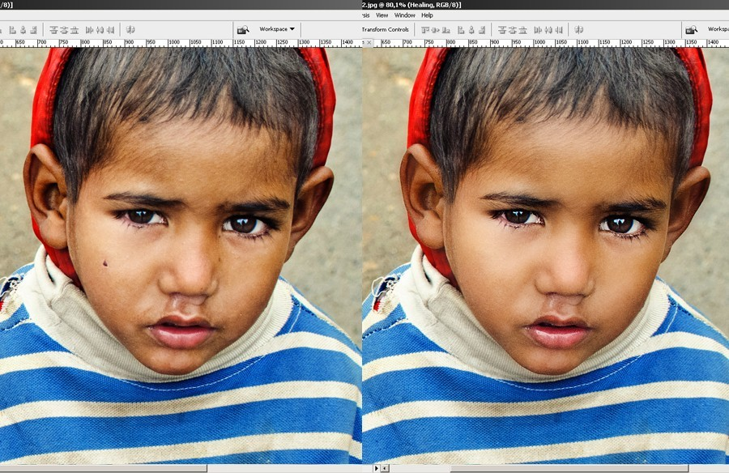
Image Processing
Smoothing

Slide 19



Image Processing
Erosion and Dilation
Used to diminish or accentuate features Erode + Dilate = Removal of stray marks
Erosion
erode( src, erosion_dst, element );
Dilation
dilate( src, dilation_dst, element );

Slide 20
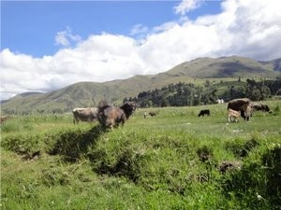
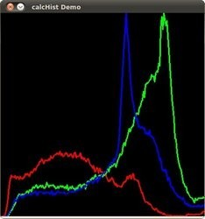
Image Processing
Histogram calculation

Slide 21
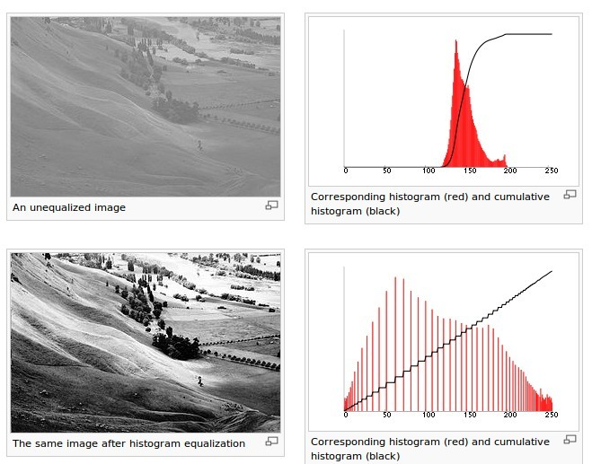
Image Processing
Histogram equalisation – Improves contrast cvEqualizeHist( img, out );

Slide 22
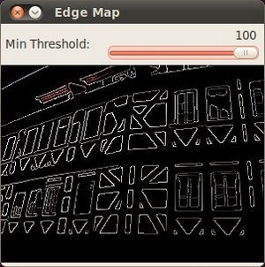
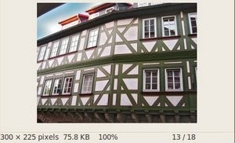
Image Processing
Edge detection

Slide 23
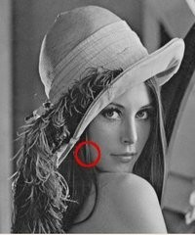
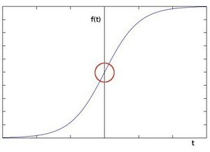
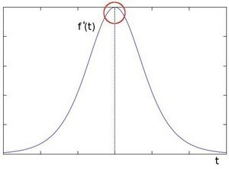
Image Processing
Sobel Edge Detector

Slide 24
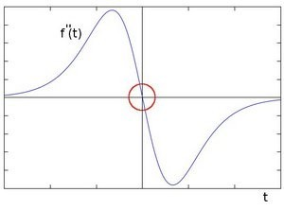
Image Processing
Laplace Edge Detector

Slide 25
Image Processing
Canny Edge Detector
Best edge detector available
Uses more advanced intensity gradient based methods

Slide 26
Feature Detection
The following 3 are considered to be keypoints in an image
Edges
Corner (also known as interest points)
Blobs (also known as regions of interest )
Once the features have been found, these features are „described“. That is, the details around the keypoints are recorded.
Later these descriptors are matched against incoming images.

Slide 27
Feature Detection
Feature Extraction: SURF, SIFT, BRIEF
Feature Descriptors: SURF, SIFT, BRIEF, STAR Matchers: FLANN, BruteForce

Slide 28
Thank You :)
debayan@uberlabs.net

